Slide 1

Stress Management

Slide 2
How have you been?

Slide 3
STRESS
What stresses a zebra?
(Robert Saplosky, Why Zebras Don’t Get Ulcers)

Slide 4
STRESS
for animals, stress is often acute, physical, responsive
for people in industrial society, stress is often chronic, psychosocial, anticipatory

Slide 5
STRESS
psychological and physiological response to a stimulus (stressor) that alters the body’s equilibrium

Slide 6

Is stress always bad?

Slide 7
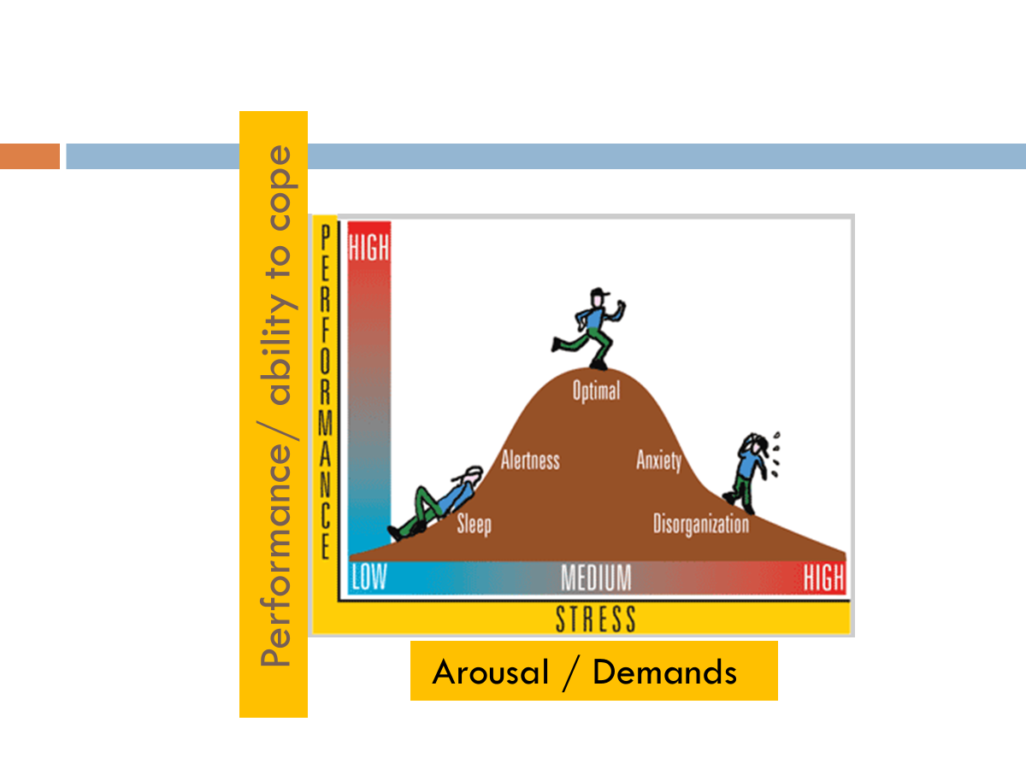

Slide 8
Psychological Modifiers of the Stress Response
Outlets for frustration (How am I releasing the stress)
Sense of predictability and of control
A perception of life improving
Social support
(Weiss, Levine, Sehgman)

Slide 9
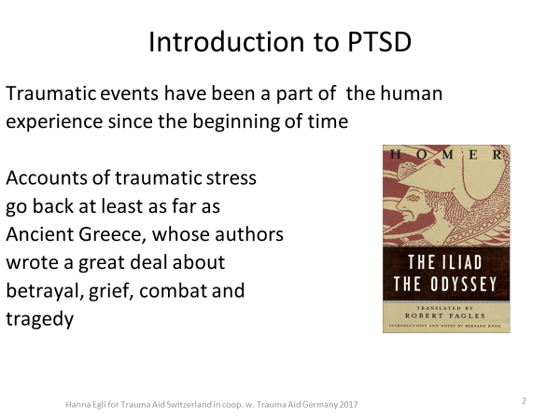

Slide 10
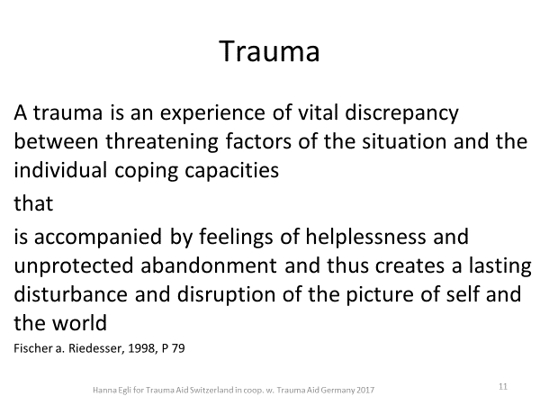

Slide 11
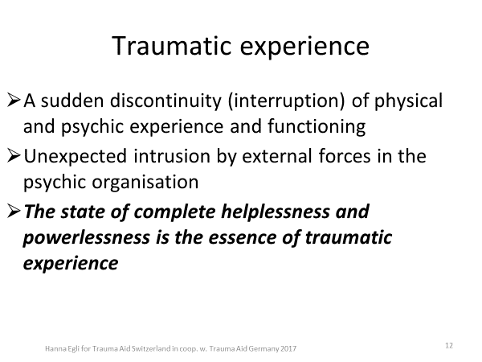

Slide 12
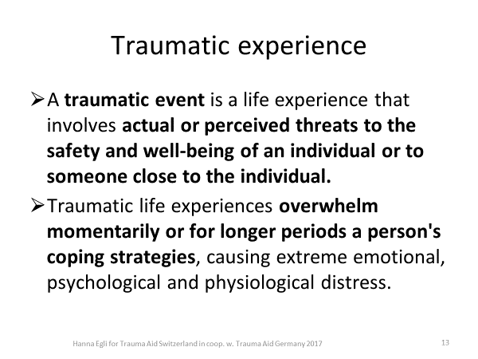

Slide 13
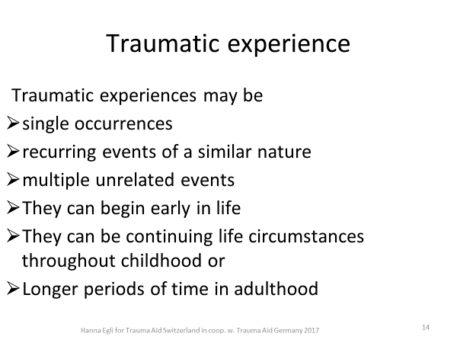

Slide 14
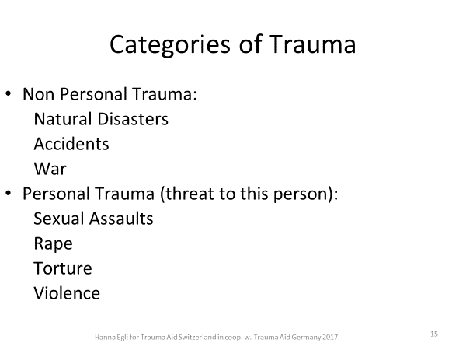

Slide 15
Signs of PTSD
Intrusive memories
Symptoms of intrusive memories may include:
Unwanted, distressing memories of a traumatic event that come back over and over again.
Reliving a traumatic event as if it were happening again, also known as flashbacks.
Upsetting dreams or nightmares about a traumatic event.
Severe emotional distress or physical reactions to something that reminds you of a traumatic event.

Slide 16
Signs of PTSD
Avoidance
Symptoms of avoidance may include:
Trying not to think or talk about a traumatic event.
Staying away from places, activities or people that remind you of a traumatic event.

Slide 17
Signs of PTSD
Negative changes in thinking and mood
Symptoms of negative changes in thinking and mood may include:
Negative thoughts about yourself, other people or the world.
Ongoing negative emotions of fear, blame, guilt, anger or shame.
Memory problems, including not remembering important aspects of a traumatic event.
Feeling detached from family and friends.
Not being interested in activities you once enjoyed.
Having a hard time feeling positive emotions.
Feeling emotionally numb.

Slide 18
Signs of PTSD
Changes in physical and emotional reactions
Symptoms of changes in physical and emotional reactions, also called arousal symptoms, may include:
Being easily startled or frightened.
Always being on guard for danger.
Self-destructive behavior, such as drinking too much or driving too fast.
Trouble sleeping.
Trouble concentrating.
Irritability, angry outbursts or aggressive behavior.
Physical reactions, such as sweating, rapid breathing, fast heartbeat or shaking.
For children 6 years old and younger, symptoms also may include:
Reenacting a traumatic event or aspects of a traumatic event through play.
Frightening dreams that may or may not include aspects of a traumatic event.

Slide 19
Let’s identify inner resources

Slide 20
Myths about Self Care
1.Self-care is being selfish
2: The effects of self-care are temporary
3: Self-care is just for women
4: Self-care takes too much time
5: Self-care is doing anything that soothes you
6: Self-care is the same for everyone

Slide 21
Self care for PTSD
Appreciate yourself and others
Do yoga, meditation, and physical Exercise
Pass some exclusive “ME” time
Set boundaries
Share responsibility
Take responsibility of your own acts
Read something that inspires you and teaches you something new
Look in the mirror and compliment yourself
Reflect on what you’re grateful for and appreciate often

Slide 22
Self care for PTSD
Learn how to say no
Forgive self and others
Writing journal
Identify and use the strengths
Enhance social relationship
Take professional support (individual/group counseling, workshop/training) when needed
Believe in YOURSELF!

